Slide 1
Azienda Agricola Giacomo Grassi
Via Dudda, 33 - Dudda - 50022 Greve in Chianti (Florence) - Italy
http://www.giacomograssi.com/

Slide 2
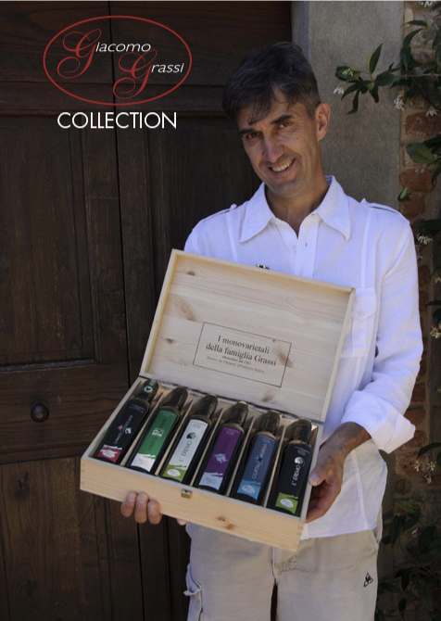
Company Summary
Giacomo Grassi was born in 1970 from a family of tenants. Since he was a child, together with his grandfather Olinto and his father Rolando, he started working in the fields of his family.
He earned a degree in agricultural sciences while he was working for the family farm.
Currently the estate has a total surface of 30 hectares, 4 ha of vineyards, 10 ha of olive groves for a total of 5000 olive trees and almost 15 ha of wood.
For over 20 years the estate has focused its production on monocultivar olive oils from native varieties of Tuscany.
Nowadays we are a leading estate in Italy in the production of monocultivar and blend olive oils.
We grow 16 different monocultivar varieties in such a small territory as it is Tuscany region.

Slide 3
Company History
1970
1987
1996
1999
2006
Present
Giacomo starts focusing on the ancient olive oil varieties «monocultivars»
Giacomo meets Fiammetta who gives an incredible boost to the estate thanks to her know-how
Birth of Giacomo Grassi
The olive trees have to be replanted due to the freeze
Bachelor’s Degree in Agricultural Sciences
Azienda Agricola Giacomo Grassi is a leading estate in the production of monocultivar and blend olive oils
Azienda Agricola Giacomo Grassi is officially an estate

Slide 4
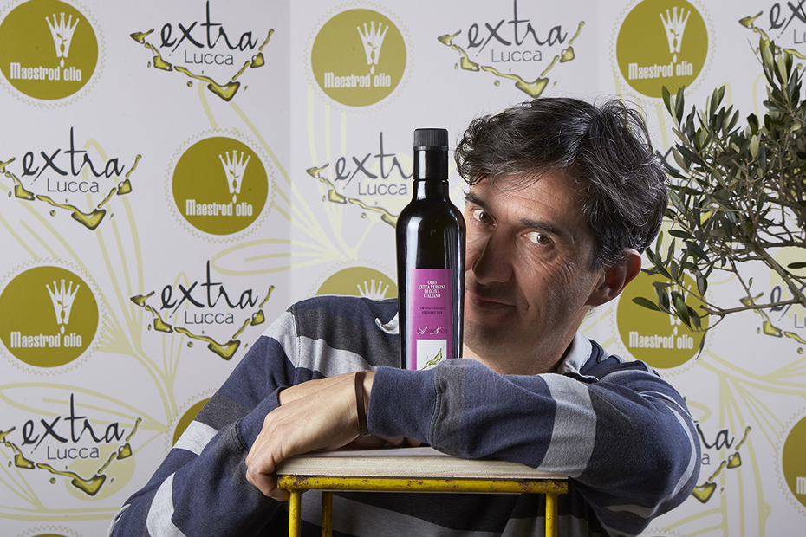
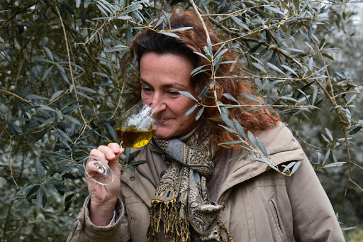
Meet the Team
From father to son in the years…
Giacomo Grassi
Owner and Producer
Fiammetta Nizzi Grifi
Agronomist

Slide 5
Mission
Vision
Values
Our mission is growing every year the highest quality olive oils through our fields.
We cannot change what Nature offers every year and therefore our products are every year the result of Nature
Good olive oil means good life
We want to be a leading company in the production of very high quality olive oils worldwide
There’s a never ending training process that we follow every year to be up to date on the latest production techniques
Integrity
Trust
Passion
Loyalty

Slide 6
“
Among the best 2020 olive oils thanks to the fragrances of tomato, fresh herbs and cytrus notes
“
Der Feinschmecker

Slide 7
Contact us
http://www.giacomograssi.it/
+393284198368
+393355725622
+393355391535

